Slide 1
PROGRAMMING IN PYTHON

Slide 2
Introduction to NumPy
arrays vs lists,
array creation routines,
arrays from existing data,
indexing and slicing,
Operations on NumPy arrays,
array manipulation,
broadcasting,
binary operators,
NumPy functions: mathematical functions, statistical functions, sort, search and counting functions

Slide 3
arrays vs lists
An array is also a data structure that stores a collection of items. Like lists, arrays are ordered, mutable, enclosed in square brackets, and able to store non-unique items.
A list in Python is a collection of items which can contain elements of multiple data types.
A array in Python is a collection of items which can contain elements of same data types
The Python array module requires all array elements to be of the same type.
On the other hand, NumPy arrays support different data types.

Slide 4

NumPy stands for Numerical Python
NumPy is a Python library used for working with arrays.
In Python we have lists that serve the purpose of arrays, but they are slow to process.
NumPy aims to provide an array object that is up to 50x faster than traditional Python lists.
The array object in NumPy is called ndarray, it provides a lot of supporting functions

Slide 5
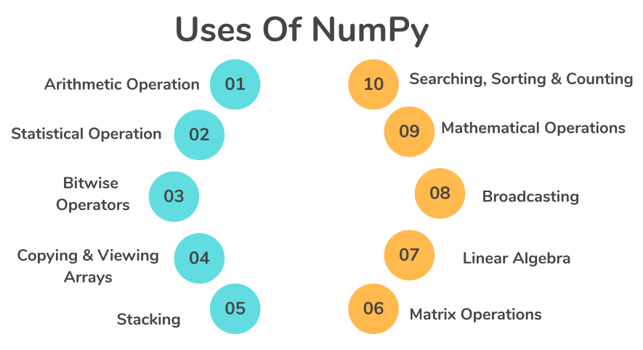

Slide 6
Python, you'll need to import this data structure from the NumPy package or the array module.

Slide 7
Installation of NumPy
!pip install numpy
Once NumPy is installed, import it in your applications by adding the import keyword:
import numpy
Create an alias with the as keyword while importing:
import numpy as np
Checking NumPy Version
The version string is stored under __version__ attribute
import numpy as np
print(np.__version__)

Slide 8
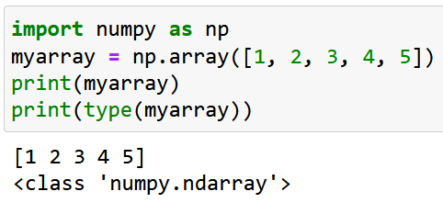
N-Dimensional array(ndarray) in Numpy
NumPy is used to work with arrays.
The array object in NumPy is called ndarray.
We can create a NumPy ndarray object by using the array() function.
To create an ndarray, we can pass a list, tuple or any array-like object into the array() method, and it will be converted into an ndarray

Slide 9
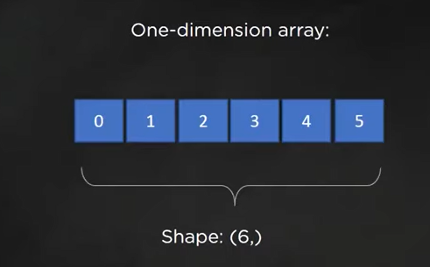
Create a 1-D array containing the values 0,1,2,3,4,5:
In numpy dimensions are called rank or axes.
Size of the array along each dimension is known as shape of the array

Slide 10
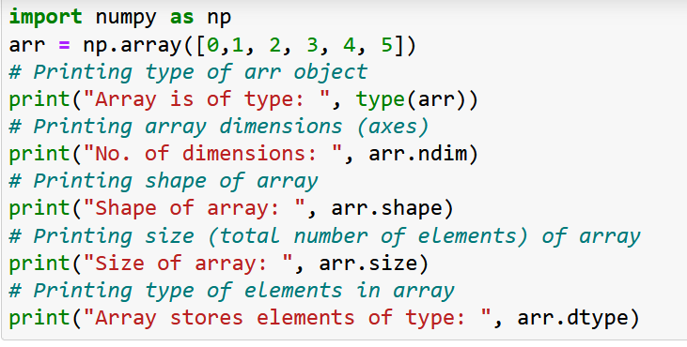
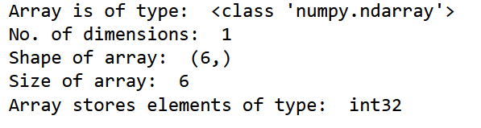

Slide 11
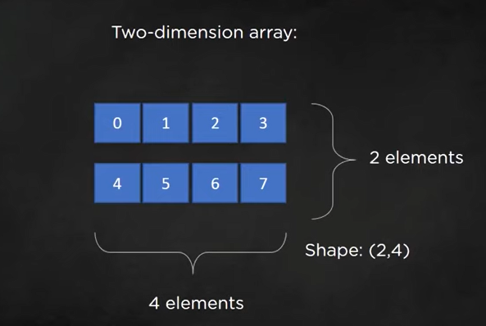

Slide 12
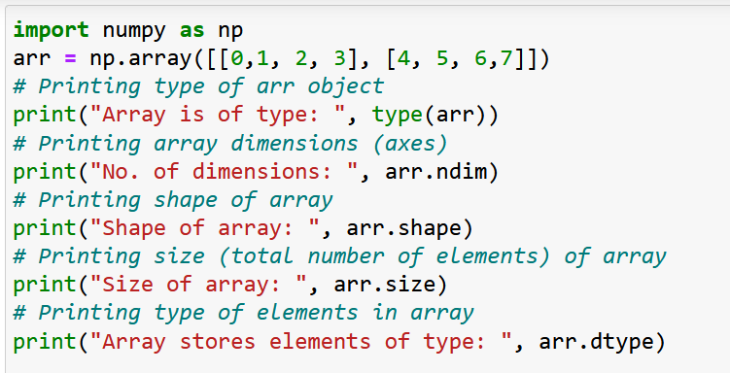
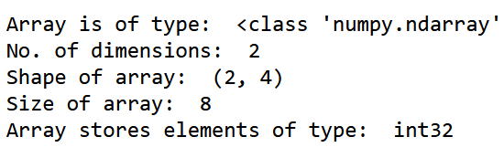

Slide 13
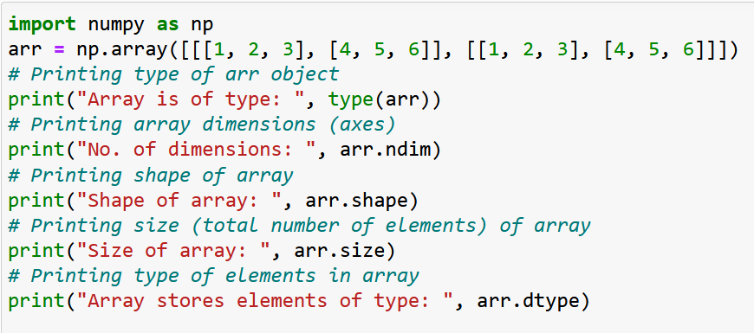
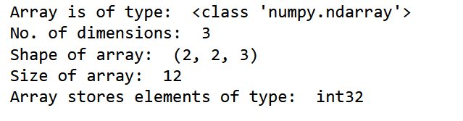

Slide 14
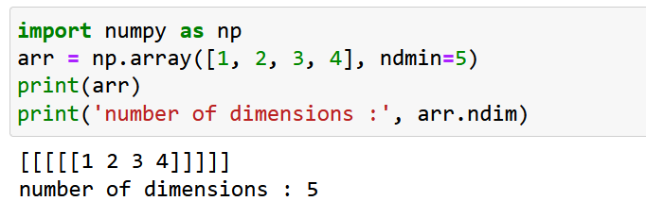
An array can have any number of dimensions.
When the array is created, you can define the number of dimensions by using the ndmin argument.

Slide 15
There are various ways to create arrays in NumPy:
You can create an array from a regular Python list or tuple using the array function.
Functions to create arrays:
Using arange() function to create a Numpy array.

Slide 16
Using arange() function to create a Numpy array:
arange(start, end, step)
Example:
arange_array = np.arange(0,11,2)
print(arange_array)

Slide 17
Reverse Array
arr2 = np.arange(20,0,-1)
print("Reverse Array", arr2)

Slide 18
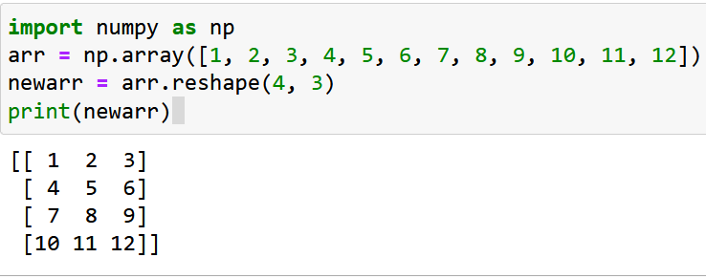
Reshaping arrays
Reshaping means changing the shape of an array.
The shape of an array is the number of elements in each dimension.
By reshaping we can add or remove dimensions or change number of elements in each dimension.

Slide 19
array creation routines
The ndarray object can be constructed by using the following routines:
Numpy.empty
The empty routine is used to create an uninitialized array of specified shape and data type.
The syntax is given below.
numpy.empty(shape, dtype = data_type)

Slide 20
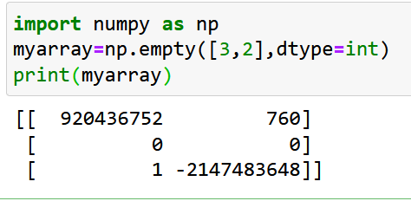
import numpy as np
arr = np.empty([3,2], dtype = int)
print(arr)

Slide 21
NumPy.Zeros
This routine is used to create the numpy array with the specified shape where each numpy array item is initialized to 0.
import numpy as np
arr = np.zeros((3,2), dtype = int)
print(arr)

Slide 22
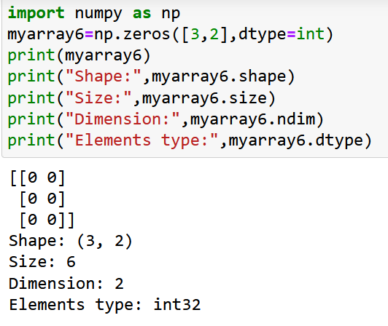

Slide 23
NumPy.ones
This routine is used to create the numpy array with the specified shape where each numpy array item is initialized to 1.
import numpy as np
arr = np.ones((3,2), dtype = int)
print(arr)

Slide 24
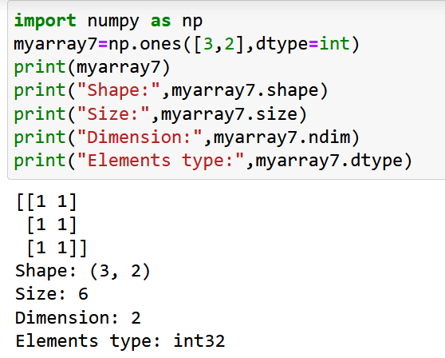

Slide 25
Array From Existing Data numpy.asarray()
Difference array() and asarray() function:
The main difference is that when you try to make a numpy array using np.array, it would create a copy of the object array and not reflect changes to the original array. On the other hand, when you use numpy asarray, it would reflect changes to the original array.

Slide 26
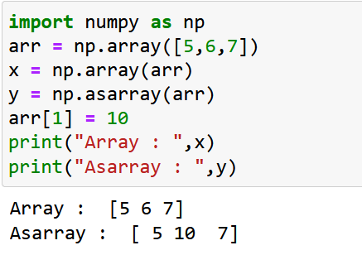

Slide 27
NumPy Bitwise Operators
bitwise_and
bitwise_or
invert
left_shift
right_shift

Slide 28
bitwise_and
import numpy as np
a = 10
b = 12
print("binary representation of a:",bin(a))
print("binary representation of b:",bin(b))
print("Bitwise and of a and b: ",np.bitwise_and(a,b))

Slide 29
bitwise_or Operator
import numpy as np
a = 50
b = 90
print("binary representation of a:",bin(a))
print("binary representation of b:",bin(b))
print("Bitwise-or of a and b: ",np.bitwise_or(a,b))

Slide 30
Invert operation
It is used to calculate the bitwise not operation

Slide 31
left_shift()
import numpy as np
a = 10
print ('Left shift of 10 by two positions:')
print (np.left_shift(10,2))

Slide 32
right_shift
import numpy as np
print 'Right shift 40 by two positions:'
print np.right_shift(40,2)

Slide 33
String functions
numpy.char.add()
import numpy as np
print ('Concatenate two strings:’ )
print (np.char.add(['hello'],[' xyz’]))

Slide 34
numpy.char.multiply()
import numpy as np
print( np.char.multiply('Hello ‘,3))

Slide 35
numpy.char.center()
This function returns an array of the required width so that the input string is centered and padded on the left and right with fillchar.
import numpy as np
# np.char.center(arr, width,fillchar)
print (np.char.center('hello', 20,fillchar = '*’))

Slide 36
numpy.char.capitalize()
This function returns the copy of the string with the first letter capitalized.
import numpy as np
print( np.char.capitalize('hello world’))

Slide 37
Operations on NumPy arrays
You can perform arithmetic directly on NumPy arrays, such as addition and subtraction.
For example, two arrays can be added together to create a new array where the values at each index are added together.

Slide 38
import numpy as np
a = np.array([1, 2, 3])
b = np.array([1, 1, 1])
c = a + b
print(c)
[1,2,3,1,1,1]
[1,1,1,1,2,3]
[2,3,4]
None

Slide 39
import numpy as np
a = np.array([1, 2, 3])
b = np.array([1, 1, 1])
c = a + b
print(c)
a = [1, 2, 3]
b = [1, 1, 1]
c = a + b
c = [1 + 1, 2 + 1, 3 + 1]

Slide 40
Limitation with Array Arithmetic
Arithmetic may only be performed on arrays that have the same dimensions and dimensions with the same size.
Arrays with different sizes cannot be added, subtracted, or generally be used in arithmetic.
A way to overcome this use array broadcasting and is available in NumPy

Slide 41
arithmetic operations
For performing arithmetic operations such as add(), subtract(), multiply(), and divide() must be of the same shape.
import numpy as np
a = np.array([10,20,30])
b = np.array([1,2,3])
print(a.shape)
print(b.shape)
print(np.add(a,b))
print(np.subtract(a,b))
print(np.multiply(a,b))
print(np.divide(a,b))

Slide 42
Example:
import numpy as np
a1=np.array([10,20,30])
b1=np.array([1,2,3,4])
print(a1+b1)

Slide 43
You can perform arithmetic operations with different dimension using broadcasting rule :
Main rule:
Size of each dimension should be same
Size of one of the dimension should be 1.

Slide 44
array broadcasting rule
Rule1: If the two arrays differ in their number of dimensions, the shape of the one with fewer dimensions is padded with ones on its leading (left) side.
Rule2: If the shape of the two arrays does not match in any dimension, the array with shape equal to 1 in that dimension is stretched to match the other shape.
Rule3: If in any dimension the sizes disagree and neither is equal to 1, an error is raised.

Slide 45
Check with example:
a1=[10,20,30]
shape:3
dimension:1D
b1=[1,2,3,4]
shape:4
dimension:1D
Rule1: not satisfied
Rule2:not satisfied
import numpy as np
a1=np.array([10,20,30])
b1=np.array([1,2,3,4])
print(a1+b1)

Slide 46
Example-2
import numpy as np
a1=np.array([10,20,30])
b1=np.array([[1,2,3],[1,1,1]])
print(a1+b1)
Output:-[[11 22 33]
[11 21 31]]

Slide 47
mathematical functions
1. Arithmetic Functions
2. Trigonometric Functions
3. Logarithmic and Exponential Functions
4. Rounding Functions

Slide 48
1. Arithmetic Functions
NumPy Add function
add()
This function is used to add two arrays. If we add arrays having dissimilar shapes we get “Value Error”.
NumPy Subtract function
subtract()
We use this function to output the difference of two arrays. If we subtract two arrays having dissimilar shapes we get “Value Error”.

Slide 49
1. Arithmetic Functions
NumPy Multiply function
multiply()
We use this function to output the multiplication of two arrays. We cannot work with dissimilar arrays.
NumPy Divide Function
divide()
We use this function to output the division of two arrays. We cannot divide dissimilar arrays.

Slide 50
1. Arithmetic Functions
NumPy Mod and Remainder function:
mod()
remainder()
We use both the functions to output the remainder of the division of two arrays.

Slide 51
2. Trigonometric Functions
np.sin()- It performs trigonometric sine calculation element-wise.
np.cos()- It performs trigonometric cosine calculation element-wise.
np.tan()- It performs trigonometric tangent calculation element-wise.
np.arcsin()- It performs trigonometric inverse sine element-wise.
np.arccos()- It performs trigonometric inverse of cosine element-wise.
np.arctan()- It performs trigonometric inverse of tangent element-wise.

Slide 52
Example 1: Compute Sine of the Angles
import numpy as np
# array of angles in radians
angles = np.array([0, 1, 2])
print("Angles:", angles)
# compute the sine of the angles
sine_values = np.sin(angles)
print("Sine values:", sine_values)
Output:-Angles: [0 1 2]
Sine values: [0. 0.84147098 0.90929743]

Slide 53
Exponential and Logarithmic Functions
np.exp()- This function calculates the exponential of the input array elements.
np.log()- This function calculates the natural log of the input array elements. Natural Logarithm of a value is the inverse of its exponential value.

Slide 54
Rounding Functions
np.around()- This function is used to round off a decimal number to desired number of positions. The function takes two parameters: the input number and the precision of decimal places.
np.floor()- This function returns the floor value of the input decimal value. Floor value is the largest integer number less than the input value.

Slide 55
Sort, Search & Counting Functions
There are various sorting algorithms like quicksort, merge sort and heapsort which is implemented using the numpy.sort() function.
Syntax:
numpy.sort(input, axis, kind, order)
input: It represents the input array which is to be sorted.
axis: It represents the axis along which the array is to be sorted. If the axis is not mentioned, then the sorting is done along the last available axis.
kind: It represents the type of sorting algorithm which is to be used while sorting. The default is quick sort.
order: It represents the filed according to which the array is to be sorted in the case if the array contains the fields.

Slide 56
NumPy Sort, Search and Count
Functions
NumPy contains functions to perform search, sort, and count operations. There are a wide variety of functions to get the output. We can use the functions accordingly to produce the most optimum output. We can implement these functions on the array object.

Slide 57
NumPy Searching Function
We perform NumPy search operation to determine the position of a given element or value inside an array. There are functions to find the maximum, minimum
np.argmax()
This function returns the index of the maximum value in the array list.

Slide 58
1.np.argmax() This function returns the index of the maximum value in the array list.
import numpy as np
arr=np.array([[23,43],[45,67]])
print(np.argmax(arr))
Output:-3

Slide 59
2. np.nanargmax() This function returns the index of the maximum value element after ignoring ‘Not a Number’ (NaN) values present in the list.
import numpy as np
arr=np.array([[23,np.nan,43],[45,67,np.nan]])
print(np.nanargmax(arr))
Output:-4

Slide 60
3. np.argmin() This function returns the index of the minimum value in the array list.
import numpy as np
arr=np.array([[23,43],[45,67]])
print(np.argmin(arr))
Output:-0

Slide 61
4. np.nanargmin() This function returns the index of the minimum value element after ignoring ‘Not a Number’ (NaN) values present in the list.
import numpy as np
arr=np.array([[23,np.nan,43],[45,67,np.nan]])
print(np.nanargmin(arr))
Output:-0

Slide 62
5. np.extract() This function returns the array values that satisfy a particular condition.
import numpy as np
arr=np.array([[74,33],[59,98]])
a=np.mod(arr,2) ==0
print(np.extract(a,arr))
Output:-[74,98]

Slide 63
6. np.nonzero() This function search returns values that are non-zero.
import numpy as np
arr=np.array([0,56,89,0,23])
print(np.nonzero(arr))
Output:-
(array([1, 2, 4], dtype=int64),)

Slide 64
NumPy Sorting Function
There are a wide variety of sorting functions in NumPy. These NumPy Sort functions arrange the data in a particular order. We choose the best sorting algorithm depending on the output criteria. We can apply for any order over the data. There are various sorting functions available.

Slide 65
1. np.sort() This function returns an array in sorted format.
import numpy as np
arr = np.array([[16,1,47,53,87,28]])
print(np.sort(arr))
Output:-[[ 1 16 28 47 53 87]]

Slide 66
2. np.argsort() This function returns the indices of the sorted array. We can perform this along a particular axis.
import numpy as np
arr = np.array([[16,1,47,53,87,28]])
print(np.argsort(arr))
Output:- =
[[1 0 5 2 3 4]]

Slide 67
3. np.lexsort() This function returns the indices of array elements indirectly sorted by using a key sequence.We can consider the last key as the primary one.
import numpy as np
arr1 =np.array([[16,1,47,53,87,28]])
arr2 =np.array([[56,90,44,32,77,45]])
#sort by arr1 and then arr2
print(np.lexsort((arr2,arr1)))
Output:-[[1 0 5 2 3 4]]

Slide 68
NumPy Counting Function:-We can apply NumPy Count to count a specific kind of value from the array list.
Function name = np.count_nonzero()
import numpy as np
arr=np.array([[16,0,56],[2,34,0],[90,87,0]])
print(np.count_nonzero(arr))
print(np.count_nonzero(arr,axis=0))
Output:-6
[3 2 1]

Slide 69
Numpy array VS Numpy asarray
Both numpy array and numpy asarray can convert the data into ndarray. The main difference is that when you try to make a numpy array using np.array, it would create a copy of the object array and not reflect changes to the original array. On the other hand, when you use numpy asarray, it would reflect changes to the original array.

Slide 70
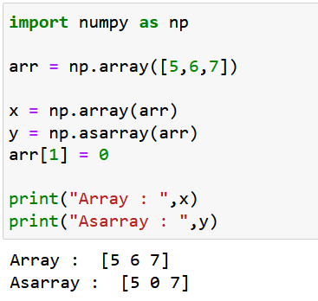

Slide 71
Example:1
import numpy as np
a = np.array([0.0, 10.0, 20.0, 30.0])
b = np.array([0.0, 1.0, 2.0])
print(a + b)

Slide 72
Example:1(modified)
import numpy as np
a = np.array([0.0, 10.0, 20.0, 30.0])
b = np.array([0.0, 1.0, 2.0])
print(a[:, np.newaxis] + b)

Slide 73
Example:1(modified)
import numpy as np
a = np.array([0.0, 10.0, 20.0, 30.0])
b = np.array([0.0, 1.0, 2.0,3.0])
print(a + b[ np.newaxis])

Slide 74
Example:2(Linear algebra)
import numpy as np
A = np.array([[6, 1, 1],[4, -2, 5],[2, 8, 7]])
print("\nInverse of A:\n", np.linalg.inv(A))
print("\nMatrix A raised to power 3:\n", np.linalg.matrix_power(A, 3))

Slide 75
Write a NumPy program to create a structured array from given student name, height, class and their data types. Now sort the array on height
import numpy as np
data_type = [('name', 'S15'), ('class', int), ('height', float)]
students_details = [('James', 5, 48.5), ('Nail', 6, 52.5),('Paul', 5, 42.10), ('Pit', 5, 40.11)]
students = np.array(students_details, dtype=data_type)
print(students)
print("Sort by height")
print(np.sort(students, order='height'))

